Slide 1
Pits and Fall in PCD clinical issues
Dr Aline Tamalet

Slide 2
Pits and Falls
How to screen patients before referring to a reference center ?
Upper and lower respiratory tract infection : what is more evocative of PCD?
What is the Predictive value of Situs Inversus for PCD ?
PCD inherance ? Some trap to avoid
Notes:
As there

Slide 3
PICADAR: a screening tool for PCD
Behan L et al . PICADAR a diagnostic predictive tool for PCD ERJ 2016
Suspicion of PCD
Non specific symptoms
Refer for diagnostic testing
n NO CBP / CBF TEM
VMHF
641
641
75 ( 12%) 566( 88%)
PCD + PCD -
641
PICADAR
> 5
N < 641
WHO ?
Notes:
Symptoms of PCD are non specific and physicians need guidance of whom to refer for diagnostic testing . The aim

Slide 4
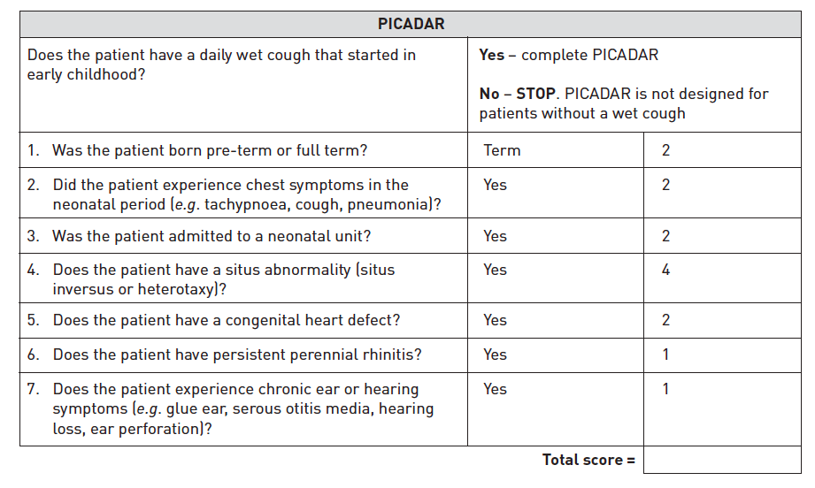
PICADAR: a screening tool for PCD
Behan L et al . PICADAR a diagnostic predictive tool for PCD ERJ 2016
B | N | P
2 | STOP | 2
0 |  | 2
0 |  | 0
0 |  | 0
0 |  | 0
1 |  | 1
1 |  | 1
4 |  | 6
Highest combined sensitivity (0,9) and specificity (0,75) was at a cut off value ≥ 5

Slide 5
PICADAR: a screening tool for PCD
Behan L et al . PICADAR a diagnostic predictive tool for PCD ERJ 2016

Slide 6
Latelarisation defect
Situs inversus
1/7000
PCD
1/16000
1 / 32000
30 à 50 % PCD with Situs Inversus
All patients with SI should not be explored for PCD
Notes:
Most of patients with situs inversus dont have PCD ( ¾) Incidence of SI is 1/7000 . Association of PCD and SI is 1/ 32 0000 Situs abnormalities reflect defective function of the 9+0 motile cilium at the node during embryogenesis . During early embryonic development ( gastulation ) cells in the ventral node contain a single motile cilium per cell. This specialized motile cilium have 9 peripheral doublets and dynein arm , but lacks the central pair of microtubules and has a rotary motion wich faciliattes development of organ laterality during embryogenesis . In the absence of normal nodal ciliary functio, organ placement is random. Mutations in genes that encode components of the 9 outer doublets result in a laterality defect ( SI or SA) in 50%of PCD. But mutations in gens that encode for components of the central apparatus ( central pair radial spoke ) does not cause laterality defects

Slide 7
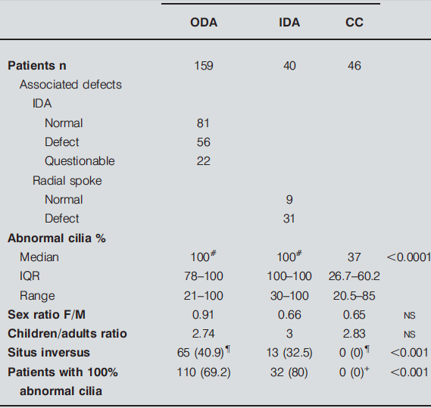
Latelarisation defect
Incidence of Situs inversus totalis
Depends on US defect.
50% if outer or inner doublets
0% if central apparatus ( CC , RS..)
Defective function of the 9+0 motile cilium at the node. Dysfunction = random placement. Only for PCD with outer doublet dysfunction
Papon JF ERJ 2009
Notes:
Mutations in genes that encode components of the 9 outer doublets result in a laterality defect ( SI or SA) in 50%of PCD. But mutations in gens that encode for components of the central apparatus ( central pair radial spoke ) does not cause laterality defects
A subset of patients with situs ambigus have heterotaxia syndroms including polysplenia and asplenia . At least 6% of PCD patients have situs ambigus and these patients have 200 fold increase of having congenital heart disease compared to general population with heterotaxy
Take homa message : 1. l’absence de situs inversus n’ exclut pas le diagnostic de DCP . 2 . In patients with chronic oto-sino-pulmonary disease and any organ laterality or cardiac defect, PCD should be considered 3 . Any patinest with PCD should be explored for subtle laterality defect and or cardiac defect

Slide 8
Latelarisation defect
Situs Ambigus + heterotaxia
12 %of PCD (Shapiro Chest 2014)
Subtle laterality defect might be undetected ( intestinal malrotation, polysplenia, interupted inferior vena cava..)
200 fold increase risk of congenital heart disease

Slide 9
Latelarisation defect
Situs solitus
Normal organ arrangement
Situs inversus totalis
Situs ambigus
Left sided cardiac index
Right sided stomac bubble
Right sided liver
Intestinal malrotation
From shapiro AJ Chest 2014

Slide 10
Latelarisation defect
1. Absence of situs inversus does not exclude PCD
2. In patients with chronic oto-sino-pulmonary disease and any organ laterality or cardiac defect, PCD should be considered
3. Any patient with PCD should be explored for subtle laterality defect and /or cardiac defect

Slide 11
No specific clinical presentation but …
Association of chronic upper and lower infection
with
High frequency of neonatal respiratory distress
Predictive of PCD OR 6,6 ( Leigh MW 2016) to 11,9 ( Behan L study ( PICADAR 2016)
Incidence vary from 44,6 % in Boon M ( 206 PCD patients 2014) study to 82 % in Davis study ( 118 PCD patients 2015)
Transient tachypnea, increased work of breathing, supplemental O2 for few hours to weeks (median of 9,5 days in Davis study) , admission in neonatal units ( median of 12 days) . +/- radiographic abnormalities ( atelectasis +/- increased perihilar markings in full term neonates, without infection .

Slide 12
No specific clinical presentation but …
Association of chronic upper and lower infection
with
High frequency of neonatal respiratory distress
Predictive of PCD OR 6,6 ( Leigh MW 2016) to 11,9 ( Behan L study ( PICADAR 2016)
Incidence vary from 44,6 % in Boon M ( 206 PCD patients 2014) study to 82 % in Davis study ( 118 PCD patients 2015)
Transient tachypnea, increased work of breathing, supplemental O2 for few hours to weeks (median of 9,5 days in Davis study) , admission in neonatal units ( median of 12 days) . +/- radiographic abnormalities ( atelectasis +/- increased perihilar markings in full term neonates, without infection .
The presence of unexplained respiratory distress in a full term infant
should raise suspicion of PCD

Slide 13
Non specific clinical presentation but …
Association of chronic upper and lower infection
with
High incidence of bronchiectasis
- 70 % in 20 children had bronchiectasis at 8,7 years
Blanchon 2010
- 100 % in 118 children 8 yrs old ( 5-11) with 3 lobes with bronchiectasis and 2 lobes with alveolar consolidation Davis 2015
- 61% in 36 children ( 8yrs) and 98 % in 47 adults ( 36 yrs) Noone 2004
mainly in lower lobes ( middle lobe, lingula and basal segments)

Slide 14
Non specific clinical presentation but …
Association of chronic upper and lower infection
with
High incidence of bronchiectasis mainly in lower lobes ( middle lobe, lingula and basal segments)
20 children with PCD longitudynal study Blanchon S 2010. 70 % of patients had bronchiectasis at 8,7 years
118 children with PCD . Davis 2015 8 yrs old ( 5-11) 100 % with 3 lobes with bronchiectasis and 2 lobes with alveolar consolidation
47 adults , Noone 2004 median age 36 yrs, 98 % of bronchiectasis and 31 children 61% in children ( 8yrs)
High incidence of bronchiectasis in PCD patients, occuring early in life
Mainly in the middle lobe and lingula (56 % ) and lower lobes ( 38%)
In contrast with CF patients where the upper lobes represent 40 %
Cohen- Cymberknoh, Chest 2014
Difference in disease expression between PCD and CF

Slide 15
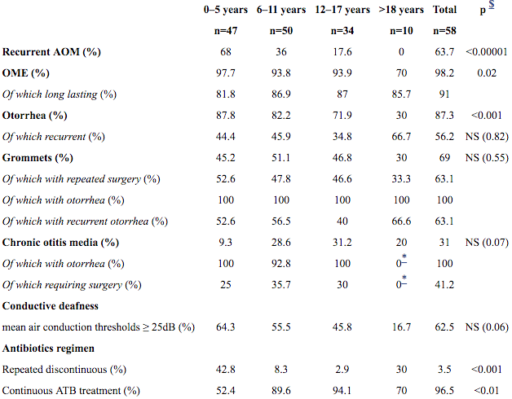
Non specific clinical presentation but …
Association of chronic upper and lower infection
with
No PCD without upper chronic airway infection
245 patients in JF papon TEM analysis. Children adult ratio 2,06. sinopulmonary syndrome 99,2 %. Isolated lower airway infection 0,4 %
Severity of otologic features in children
58 PCD patients follow up from 2 to 6 years .
V puliere 2010
Early onset year round nasal congestion OR 3,4
Early onset year round wet cough OR 3,1
- 534 patients < 18 years and 205 PCD patients Leigh MW, 2016

Slide 16
Non specific clinical presentation but …
Association of chronic upper and lower infection
with
No PCD without upper chronic airway infection
245 patients in JF papon TEM analysis. Children adult ratio 2,06. sinopulmonary syndrome 99,2 %. Isolated lower airway infection 0,4 %
Severity of otologic features in children
58 PCD patients follow up from 2 to 6 years .
V puliere 2010
Early onset year round nasal congestion OR 3,4
Early onset year round wet cough OR 3,1
- 534 patients < 18 years and 205 PCD patients Leigh MW, 2016
PCD is unlikely in the absence of
severe oto sino symptoms in early childhood

Slide 17
PCD inheritance
Heterogeneous Autosomal Recessive disorders
Higher incidence of PCD if consanguinity
16% in the UK PCD population ( Behan L 2016)
19,6 % in belgian PCD population ( Boon M 2014)
Rare families with autosomal dominant or X linked modes ( RPGR gene)

Slide 18
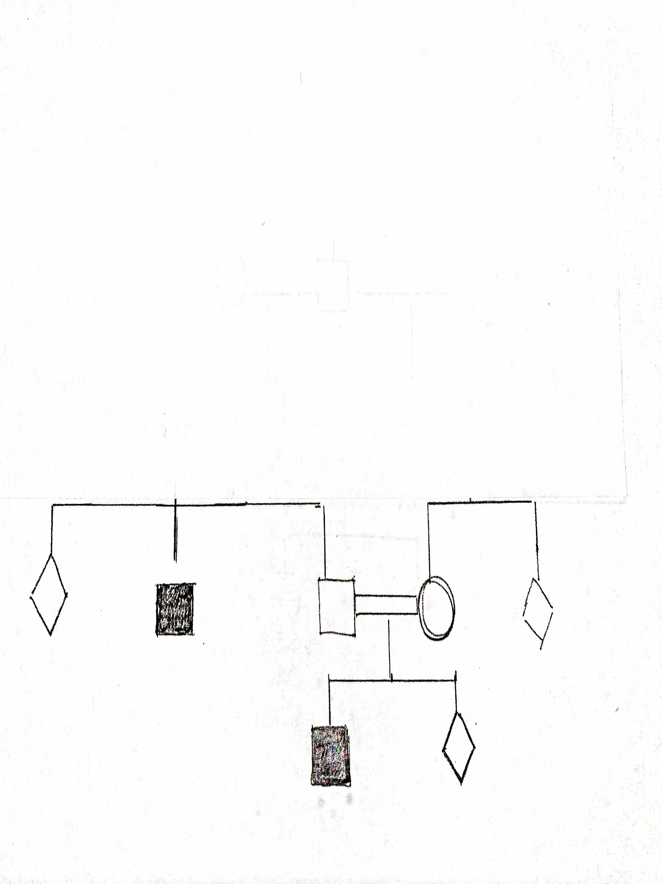
Autosomic dominant inheritance with variable penetrance ?
Notes:
Seems to be an autosomic dominant inherence as it is present in each generation ( second degree realtives = uncles)
But asking for great grand parents we had the surprise to find a double consanguinity
With is now a genealogic analysis compatible with autosomic recessive inherance

Slide 19
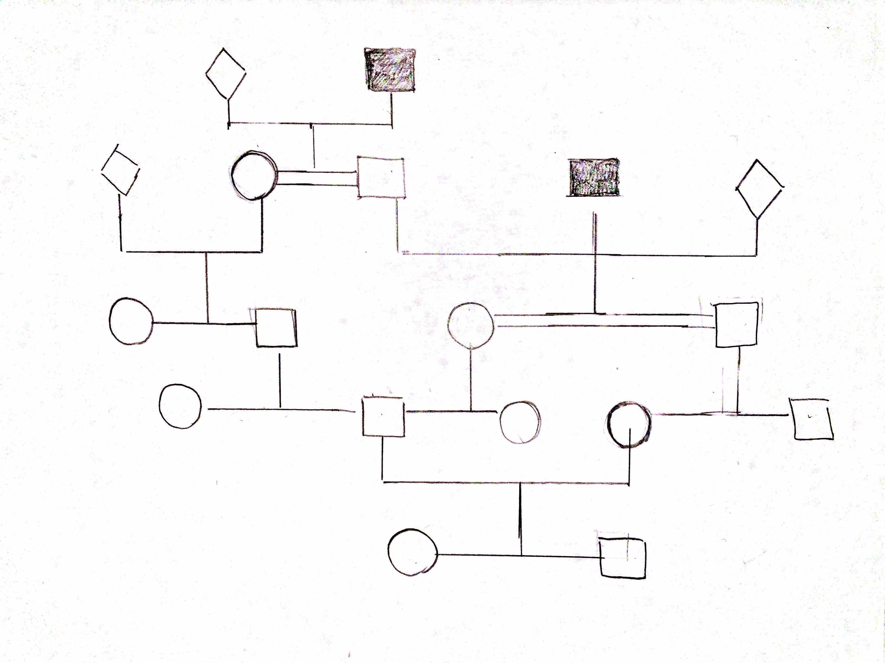
Double consanguinity !!
Notes:
But asking for great great grand parents we had the surprise to find a double cosanguinity
With is now a genealogic analysis compatible with autosomic recessive inherance
The uncle is issue from a congenital union SO there is a double consanguinity for the PCD patients

Slide 20
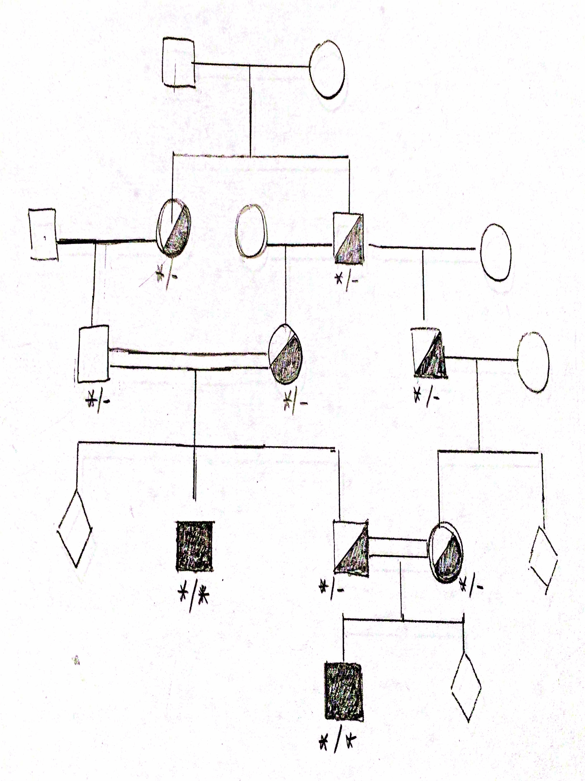
Autosomic Recessive inheritance !
Notes:
With , now , a family tree compatible with autosomic recessive inheritance

Slide 21
PCD inheritance
Heterogeneous Autosomal Recessive disorders
Higher incidence of PCD if consanguinity
16% in the UK PCD population ( Behan L 2016)
19,6 % in belgian PCD population ( Boon M 2014)
Rare families with autosomal dominant or X linked modes ( RPGR gene)
1. The importance of asking for PCD in the family and consanguinity
2. The importance of elaborating exhaustive family tree

Slide 22
Pits and Falls
Symptoms are non specific > whom to refer for testing ? PICADAR a good prédictive tool for PCD
Predictive value of Situs Inversus for PCD ? In less than 50 % of patients. ! Subtle laterality defect and congenital heart defect .
Upper and lower respiratory tract infection : what is evocative of PCD? Very early in life , Neonatal distress, severe OSS symptoms, early bronchiectasis
PCD inherance ? AR, consanguinity. Looking for PCD patient in the family ++

