Slide 1


Workshop 2: Children and adult respiratory management
Bernard MAITRE Isabelle HONORE
Services de Pneumologie Service de Pneumologie
Hôpitaux H Mondor et intercommunal Hôpital Cochin
de Créteil, université Paris XII, PRES EST Université Paris V

Slide 2
Clinical cases - Adult
  Case 1: Severe patient and lung transplantation
  Case 2: Role of macrolide antibiotics ?
  Case 3: Fertility and genetic counsel
  Case 4: Physical exercise

Slide 3
Mr, 43 years old
PCD diagnosed at 10y :
  Situs inversus
  NO 17ml/min
  Lack of both dynein arms
Nasal polyposis, pansinusitis, no earing loss
2 children (ICSI)

Slide 4
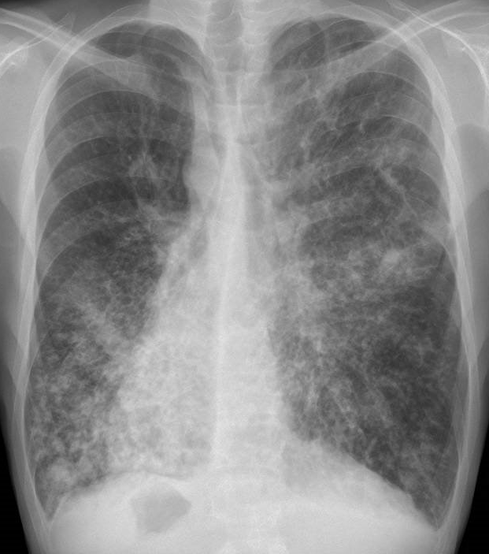
Chest X-Ray

Slide 5
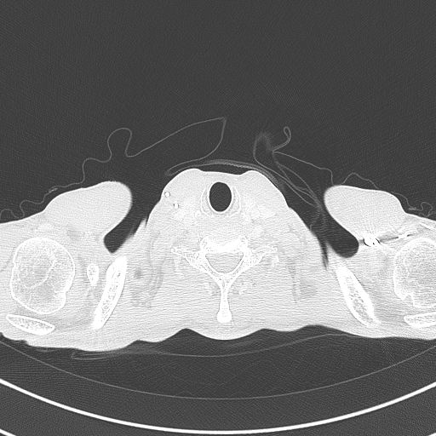
CT scan

Slide 6
Respiratory state
Diffuse bronchectiasis
FEV1 below 40% since 2004
Elevated PAP since 2010
Nocturnal oxygen since 2010
Pseudomonas since 2012
  1 IV antibiotic treatment in 2012
  4 in 2013, 5 in 2014

Slide 7
Functional tests

Slide 8
Clinical worsening
Weight loss
Antibiotic requerance (oral, IV and nebulized)
2 haemoptysis
Hypoxemia
→ assessment for lung transplantation in 2013
→ registration in october 2015

Slide 9
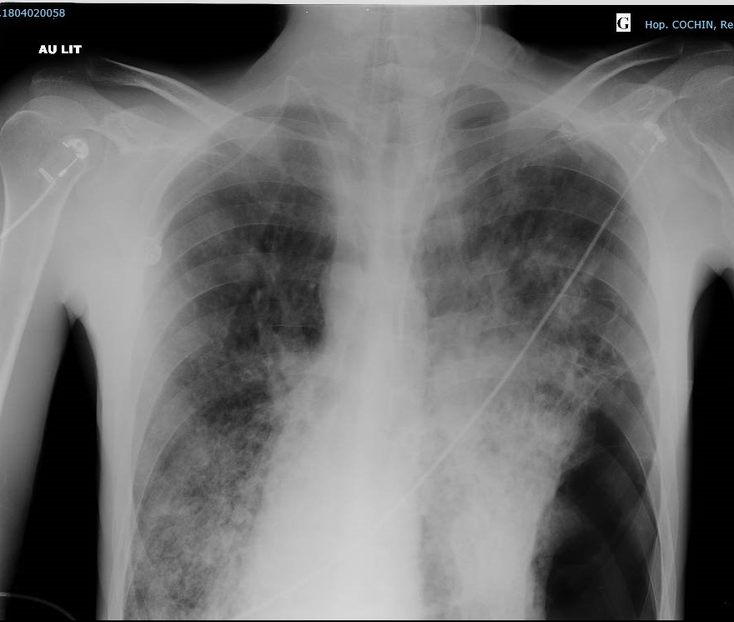
Lung Transplantation in dec 2015

Slide 10
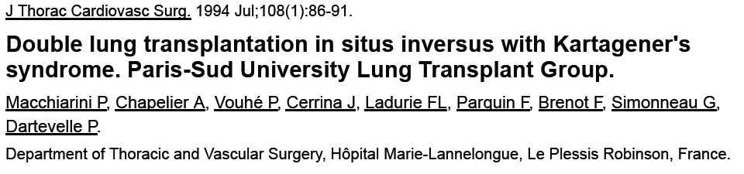
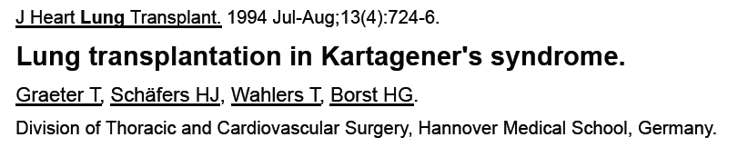
Is transplantation more difficult in PCD ?

Slide 11
When to do it ?
Local LT possibilities
The disease : life expectancy based on known data ??
The patient : treatments, physical condition, ...

Slide 12
Time in waiting list in France

Slide 13
When to do it ?
Local LT possibilities
The disease : life expectancy based on known data ??
The patient : treatments, physical condition, ...

Slide 14
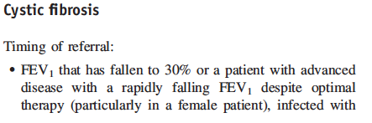
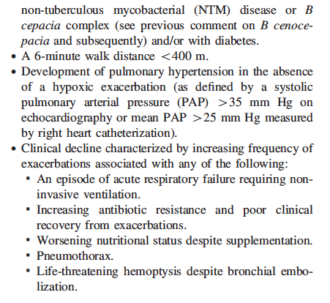

When to do it ?
FEV₁ <30%
6mWT < 400m
PAH
Clinical evaluation
2014 Update

Slide 15

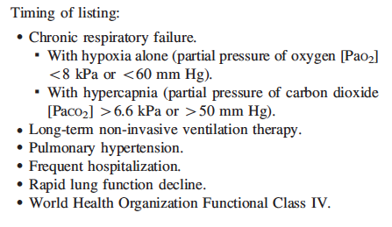
When to do it ?
PaO₂ < 60 mmHg
PaCO₂ > 50 mmHg
Non invasive ventilation
Clinical evaluation
2014 Update

Slide 16
When to do it ?
Local LT possibilities
The disease : life expectancy based on known data ??
The patient : treatments, physical condition, ...

Slide 17
How many patients concerned ?
No official statistics
In our cohort : 2 LT in 2015

Slide 18
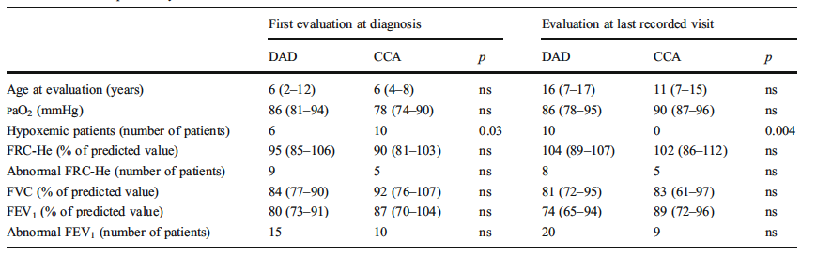
Intrinsic leads ?
VALLET Eur J Pediatr 2013

Slide 19
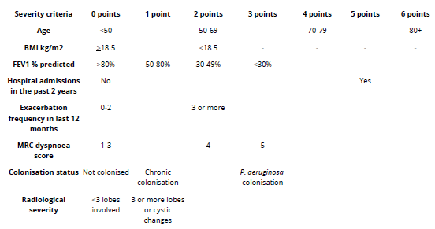
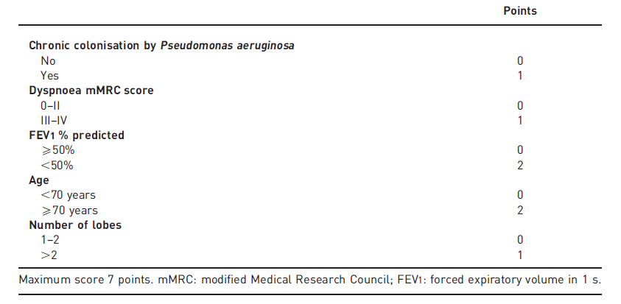
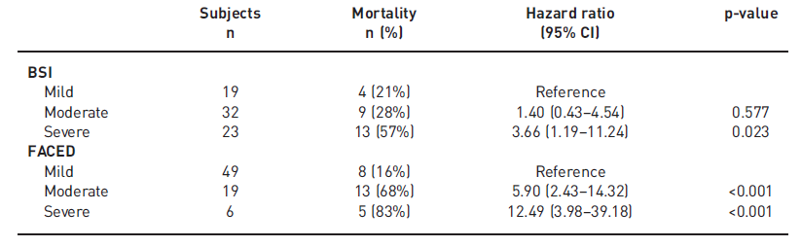
Severity score: useful for PCD ?
Bronchial severity index (BSI)
FACED score
15 years
Ellis et al ERJ 2015

Slide 20
Which follow up? How often ?
FVC/FEV₁
6MWT
Exercise test + Clinical evaluation
Nocturnal oxymetry
PaO₂/PaCO₂
Echocardiography
Imaging ?

Slide 21
Mr, 32 years old
PCD diagnosed at 22y :
  No situs inversus
  NO 9 ml/min
  CC anomalies
  RSHP4A mutation
Bronchitis/Pansinusitis
1 child

Slide 22
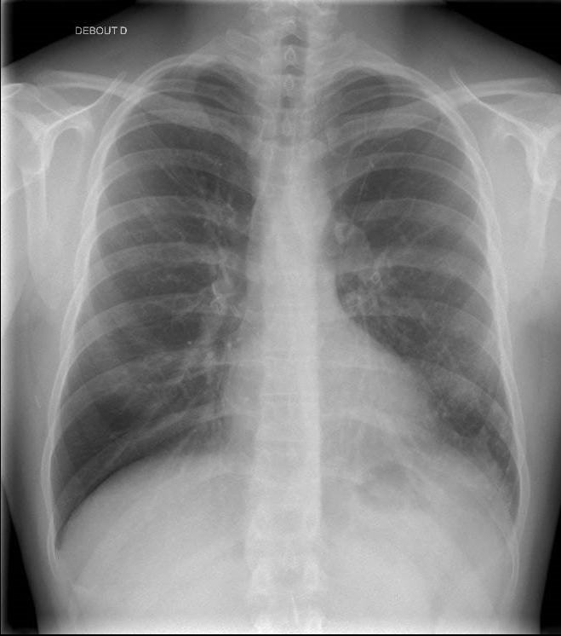
Chest X-Ray

Slide 23
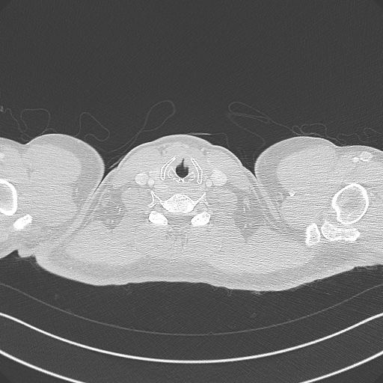
CT scan

Slide 24
Respiratory evaluation
Chronic cough, no dyspnea
FEV₁ 65%
Sport 3 times/w
No pseudomonas eradication
Antibiotics 3 times/y
→ Indication for macrolides ?

Slide 25
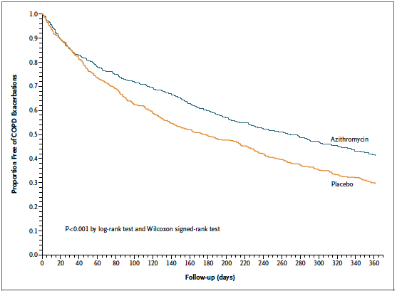
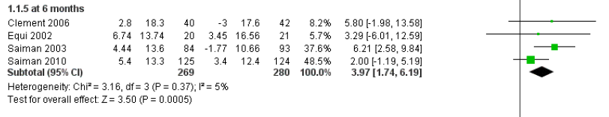
Macrolides in COPD and CF
 risk of exacerbation
 FEV1 in CF only
at 6 months
w/wo Pseudomonas
Albert NEJM 2011
Cochrane DB 2012

Slide 26
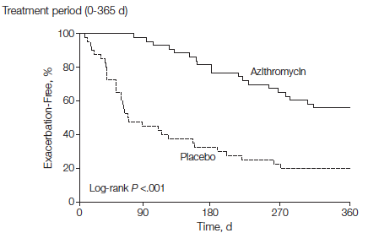
Macrolides in bronchectiasis ?
n : 83, ≥3 exacerbation/y
Azithromycin 250mg/d, 12m
Altenburg JAMA 2013

Slide 27
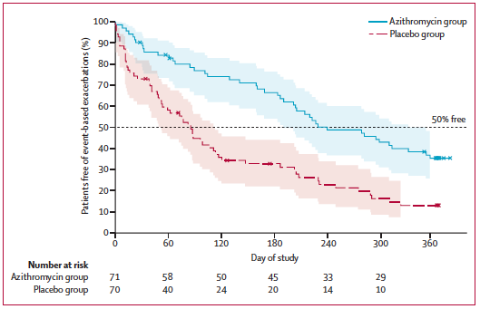
Macrolides in bronchectiasis ?
n : 141, ≥1 exacerbation/y
Azithromycin 500mg*3/w, 6m
Wong Lancet 2012

Slide 28
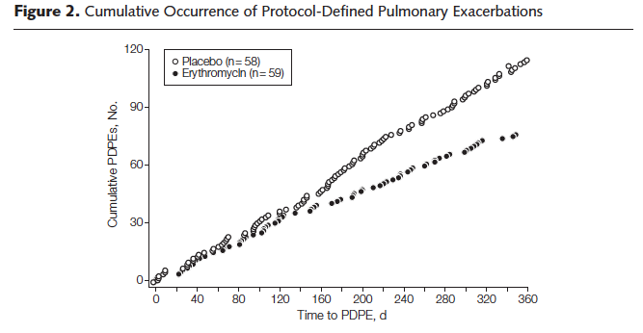
Macrolides in bronchectiasis ?
n : 117, ≥2 exacerbation/y
Erythromycin 400mg/d, 1y
Serisier Jama 2013

Slide 29
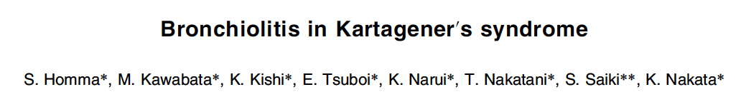

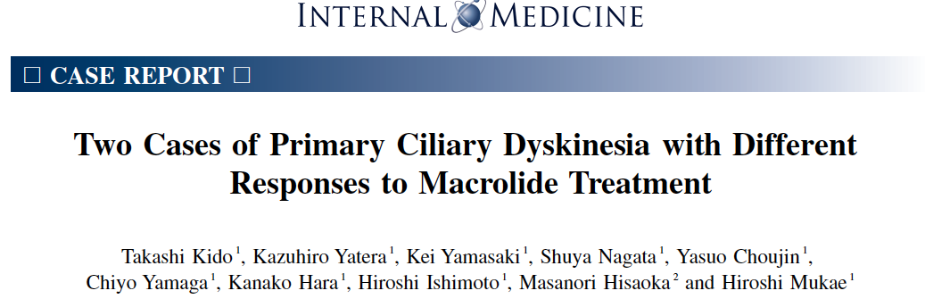
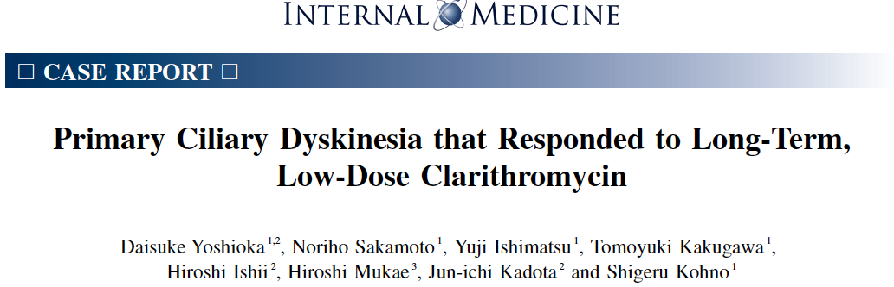
Macrolides in DCP ?
→ 32% on macrolides in our population

Slide 30
Pre-treatment check up
Liver test
ECG
Audiogram
Sputum screening for NTM disease

Slide 31
M, 34 ans
History
  1982 Neonatal respiratory distress
  1995 Lung surgery(ML) for bronchectasis (CF testing)
  Exacerbations 6/y
  Rhinosinusitis and otitis
  2009
    nNO 11 ml/min (N > 150)
    Abnormal ciliary beat
    DCP formal diagnosis (no genetic abnormality)
  2014 PA primo infection (Ciflox®+Tobi®)
  2014: question about fertility
  Sperm analysis: oligozoospermia
  ART: intra cytoplasmic sperm injection

Slide 32
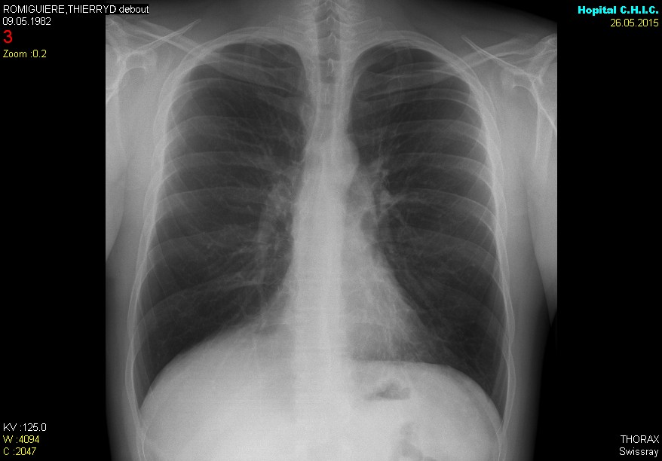

Slide 33
Fertility
14 men all infertile
12 women 3 became pregnant
Eur J Respir Dis Suppl. 1983;127:144-7.
Male and female infertility problems in the immotile-cilia syndrome.
Afzelius BA, Eliasson R.

Slide 34
12 men (KS 6)
  2 immotile spermatozoids
  4 « normal » spermatozoids ( apparently had children)
  1 oligozoospermia
  5 azoospermia

Slide 35
Fertility data in a cohort of adult patients (N= 78)
39 patients never tried to have children at the end of follow up
Among the remaining 39 patients:
  10 men (4 with dynein arm defect, 3 with abnormal central complexes, 2 with multiple defects, one with unknown defect but situs inversus) presumably have children
  10 women (5 with outer or inner dynein arms defects, 4 with unknown defect but situs inversus) had children (25.6% of the cohort) without assisted reproductive technologies.
  14 men had hypofertility (10 with dynein arms defect, 3 with abnormal central complexes and one with unknown defect)
    7 children after Intra Cytoplasmic Sperm Injection
    7 children after In Vitro Fertilization
  5 women had hypofertility (4 with dynein arms defect and one with unknown defect).
    No report of any ectopic pregnancy.
    3 patients had had miscarriages.
Frija-Masson et al, Thorax submitted

Slide 36
Fertility
Discuss this potential complication during childhood (teenage years ?)
Ask for genetic counseling (autosomal recessive disorder, rarely autosomal dominant or X-related)
  To inform parents with one child with PCD
  To possible avoid consanguinity or drawn up a family tree
  Family history of the partner (SI, bronchiectasis …)
When patients have a project to conceive
Address the male patient to sterility clinics (sperm analysis++)
Inform women to possible fertility problems
  Early screening for cardiac malformation (heterotaxy)

Slide 37
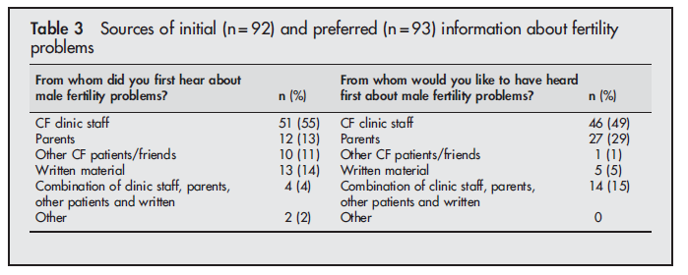
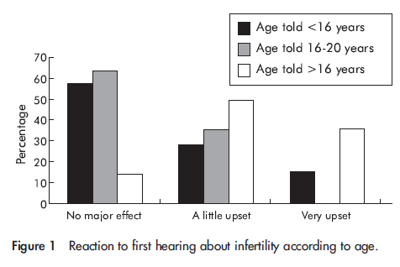
Reproductive health information:
when and which source ?
Sawyer et al
Thorax 2005

Slide 38
F, 26 ans
History
  1989 (17 M) respiratory distress and artificial ventilation
  Chronic bronchitis and « asthma »
  Otitis (symptomatic ?)
  2007 CT-scan: bronchiectasis in both lower and middle lobes
  2014
    nNO 27 ml/min (N > 150)
    Sputum: PA
    formal diagnosis of PCD (lack of dynein arm)
  2015 exertional dyspnea

Slide 39
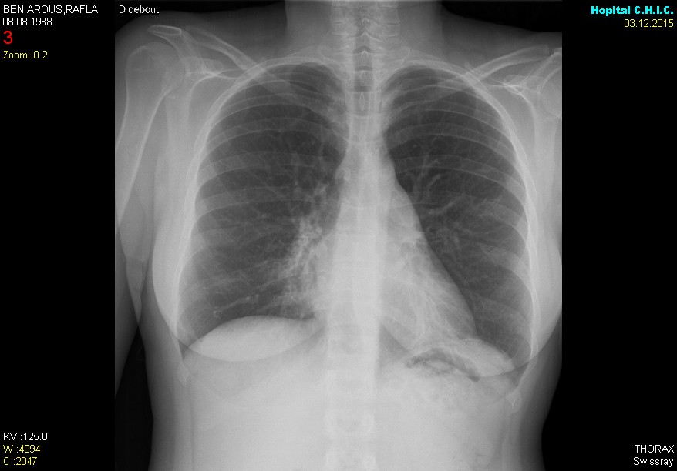

Slide 40
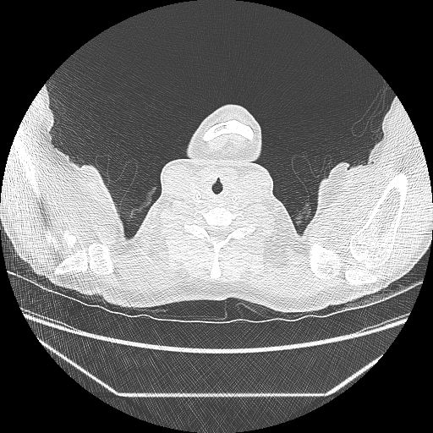
CT scan

Slide 41
6MW test
Distance : 531 m (78% P)

Slide 42
Cardiopulmonary exercise test
  VO₂max
  Max power 150 W
  VO₂ Peak 2.22 l/min 99%P
  VO₂ max 28.9 mL/kg/min
  Breathing reserve 4% (N 20-40 %)
  Limitation due to decrease of breathing reserve and
  muscle detraining
  Physical Rehabilitation during 6 months
  Increase of Walking test distance
  Decrease body weight (- 7 kgs)

Slide 43
Physical training for bronchiectasis
In non CF bronchiectasis
  Cochrane Aiways group 2005
  Among 4 studies, 2 studies Newall et al (n=46)
  Increase of endurance exercise capacity and QOL
In CF june 2015
  Among 48 studies, 13 studies met the inclusion criteria (n=402)

Slide 44
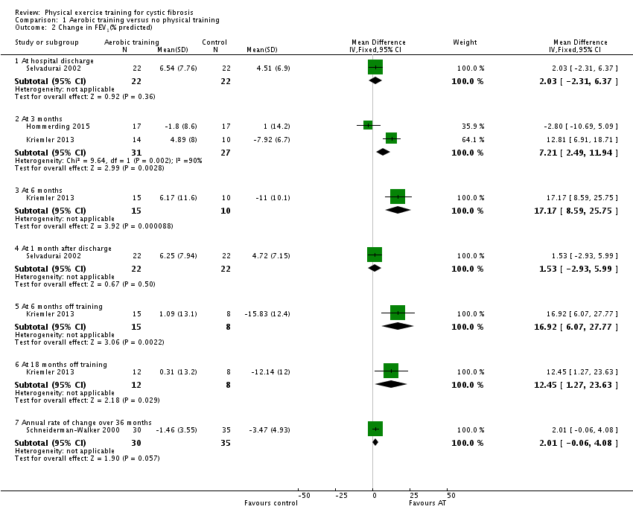
Physical exercise training for cystic fibrosis: change in FEV₁
Cochrane Database of Systematic Reviews
28 JUN 2015 DOI: 10.1002/14651858.CD002768.pub3
http://onlinelibrary.wiley.com/doi/10.1002/14651858.CD002768.pub3/full#CD002768-fig-00102
Notes:
Comparison 1 Aerobic training versus no physical training, Outcome 2 Change in FEV₁(% predicted).
IF THIS IMAGE HAS BEEN PROVIDED BY OR IS OWNED BY A THIRD PARTY, AS INDICATED IN THE CAPTION LINE, THEN FURTHER PERMISSION MAY BE NEEDED BEFORE ANY FURTHER USE. PLEASE CONTACT WILEY'S PERMISSIONS DEPARTMENT ON PERMISSIONS@WILEY.COM OR USE THE RIGHTSLINK SERVICE BY CLICKING ON THE 'REQUEST PERMISSIONS' LINK ACCOMPANYING THIS ARTICLE. WILEY OR AUTHOR OWNED IMAGES MAY BE USED FOR NON-COMMERCIAL PURPOSES, SUBJECT TO PROPER CITATION OF THE ARTICLE, AUTHOR, AND PUBLISHER.

Slide 45
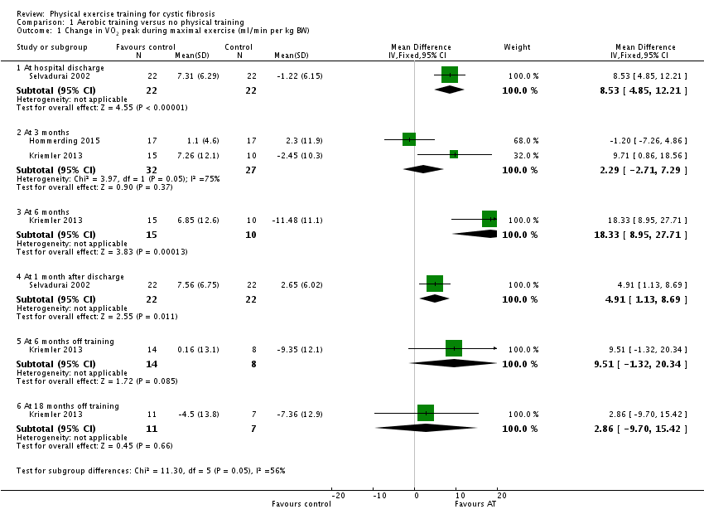
Physical exercise training for cystic fibrosis: change in VO₂ max
Cochrane Database of Systematic Reviews
28 JUN 2015 DOI: 10.1002/14651858.CD002768.pub3
http://onlinelibrary.wiley.com/doi/10.1002/14651858.CD002768.pub3/full#CD002768-fig-00101
Notes:
Comparison 1 Aerobic training versus no physical training, Outcome 1 Change in VO₂ peak during maximal exercise (ml/min per kg BW).
IF THIS IMAGE HAS BEEN PROVIDED BY OR IS OWNED BY A THIRD PARTY, AS INDICATED IN THE CAPTION LINE, THEN FURTHER PERMISSION MAY BE NEEDED BEFORE ANY FURTHER USE. PLEASE CONTACT WILEY'S PERMISSIONS DEPARTMENT ON PERMISSIONS@WILEY.COM OR USE THE RIGHTSLINK SERVICE BY CLICKING ON THE 'REQUEST PERMISSIONS' LINK ACCOMPANYING THIS ARTICLE. WILEY OR AUTHOR OWNED IMAGES MAY BE USED FOR NON-COMMERCIAL PURPOSES, SUBJECT TO PROPER CITATION OF THE ARTICLE, AUTHOR, AND PUBLISHER.

Slide 47
Microbiologic findings
 | At least once (%) | Chronic infection (%)
Haemophilus influenzae | 55 (71) | 32 (41)
Streptococcus pneumoniae | 38 (49) | 10 (13)
Pseudomonas aeruginosa | 34 (44) | 21 (27)
Staphylococcus aureus MSSA MRSA | 20 (26) | 7 (9)
 | 0 (0) | 0 (0)
Moraxella catarrhalis | 3 (3.8) | 0 (0)
Stenotrophomonas maltophilia | 2 (2.6) | 2 (2.6)
Burkholderia cepacia | 0 (0) | 0 (0)
Other pyogens | 23 (29) | 3 (3.8)
Non tuberculous mycobacteria | 2 (2.6) | 1 (1.3)
Notes:
Others?
MNT NON TRAITE?

Slide 48
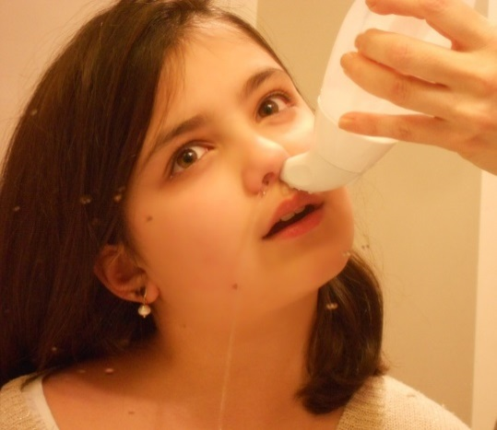
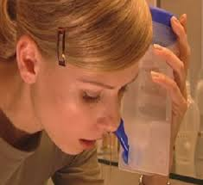
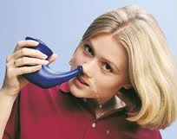
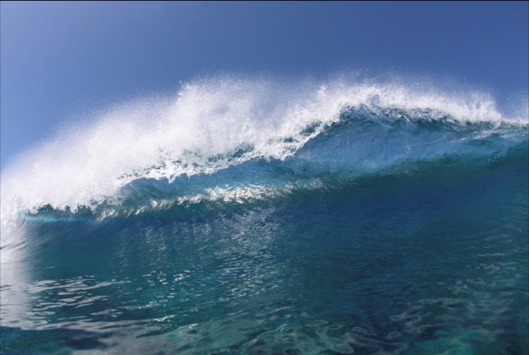
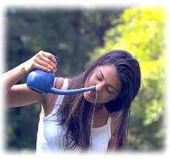
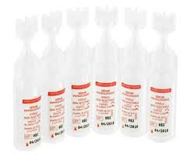
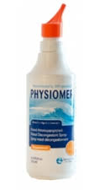
V Pruniere Escabasse
17ème assises d’ORL, Nice 29 Janvier 2015

Slide 49
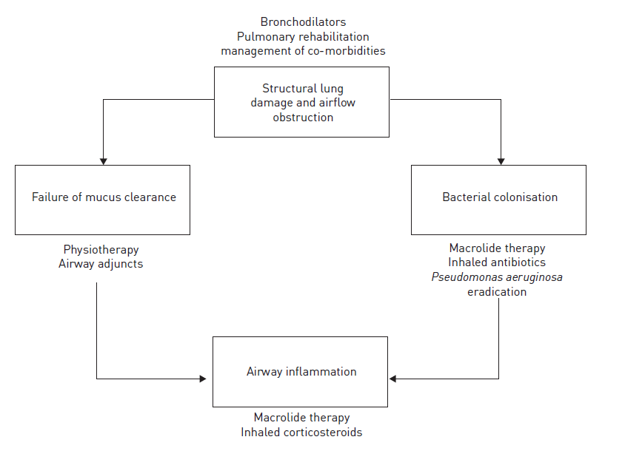
Chalmers et al ERJ 2015: 45

Slide 50
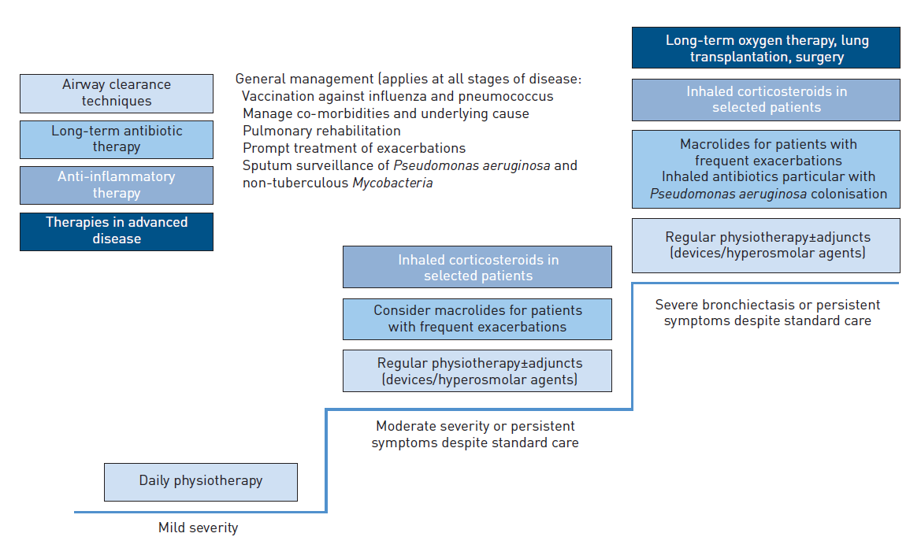
Chalmers et al ERJ 2015: 45

